Slide 1



Adventure Works Cycle Dashboard
View in Power BI
Last data refresh:
1/18/2023 3:34:36 PM UTC
Downloaded at:
1/18/2023 3:51:10 PM UTC

Slide 2
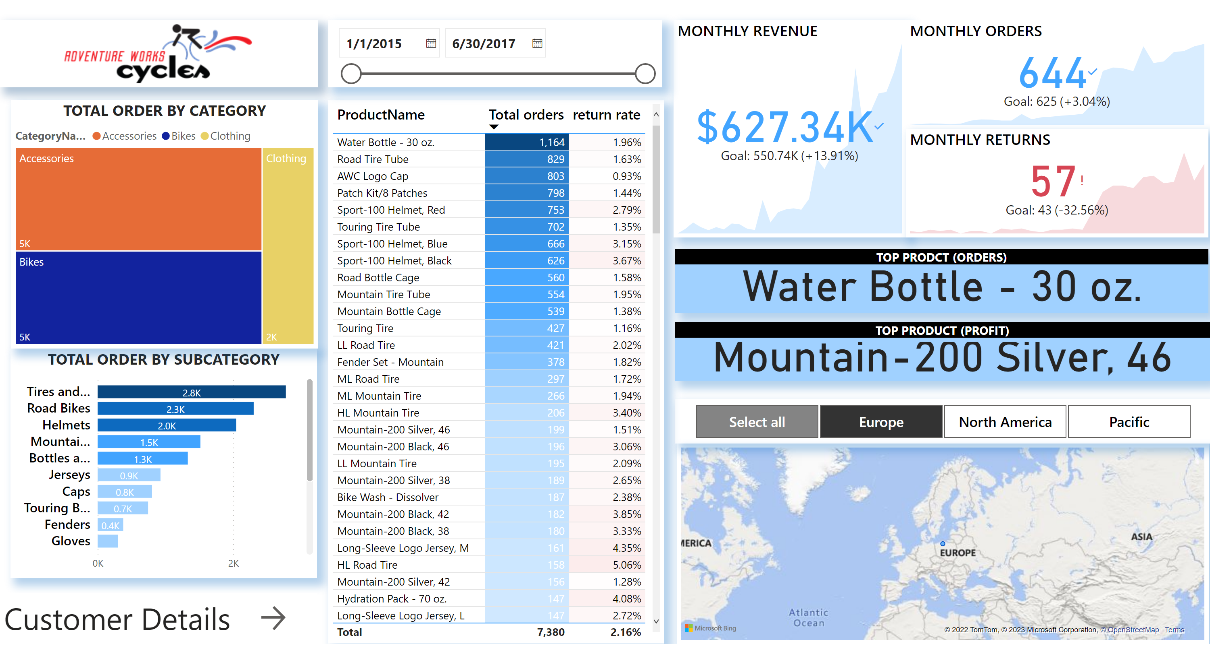
Executive summary
Notes:
image
No alt text provided
TOTAL ORDER BY SUBCATEGORY
No alt text provided
TOTAL ORDER BY CATEGORY
No alt text provided
tableEx
No alt text provided
MONTHLY REVENUE
No alt text provided
MONTHLY ORDERS
No alt text provided
MONTHLY RETURNS
No alt text provided
TOP PRODCT (ORDERS)
No alt text provided
TOP PRODUCT (PROFIT)
No alt text provided
map
No alt text provided
slicer
No alt text provided
slicer
No alt text provided
textbox
No alt text provided
actionButton
No alt text provided

Slide 3
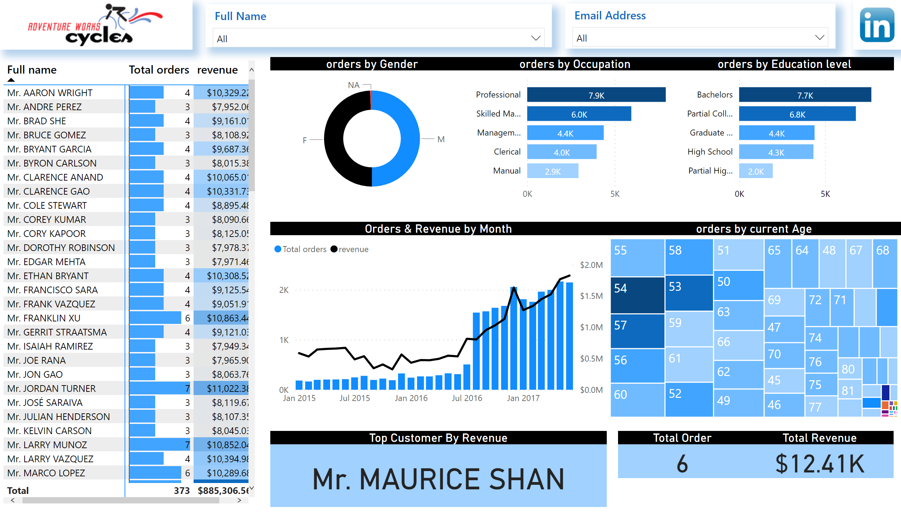
customer details
Notes:
pivotTable
No alt text provided
orders by Gender
No alt text provided
Orders & Revenue by Month
No alt text provided
orders by current Age
No alt text provided
image
No alt text provided
slicer
No alt text provided
slicer
No alt text provided
image
No alt text provided
Top Customer By Revenue
No alt text provided
orders by Education level
No alt text provided
Total Order
No alt text provided
orders by Occupation
No alt text provided
Total Revenue
No alt text provided

